Slide 1
CISC 351 Final Presentation April 12, 2022
Group 8
Stuart Finley, 10147762
Eissa Khan, 20082302
Yun(Ivy) You, 20164288
Liguang(Lee) Zhang, 10179204

Slide 2

Original Project Goal
Objective was to determine most effective vaccine combination
Found paper using data from National Board of Health and Welfare, Statistics Sweden analyzing heterogenous and homogenous vaccine effectiveness
After reaching out to authors of paper as well as the board, it was determined the data was unavailable for our use

Slide 3
Current Project Goal / Introduction
Analyze Covid-19 twitter data and determine tweet sentiment
Use text analysis to determine key words which reflect user sentiment and compare to Covid-19 vaccine rate/case count

Slide 4
Questions
Are sentiments towards covid vaccines related to vaccination rates?
How has sentiment towards covid vaccine & the pandemic changed since 2020?
Which country has a generally positive sentiment towards covid vaccines and which ones has negative sentiments?
Notes:
Ivy:
Our team will focus on three aspects: how sentiments change, are these changes related to case counts or vaccination rate, and how people from different countries perceive the vaccines available to them for administration and their local covid-19 policy
The result of daily emotional trend analysis may help show the different emotional phases since the start of the pandemic. The analysis of the number of users, and their sentiments toward the different kinds of vaccines will help us understand public attitudes to vaccines. Moreover, the analysis may reveal a mix of doubtfulness and trust for vaccine administration and covid 19 policies. The public may also express expectations for future public health measures in their tweets.
All three questions are related to define the relationship between counts of diferent emotions tweets with time periods, vaccination rates, and countries.
Main goal: using different ways to process data and build model to achieve better accuracy
Then adding new created attributes (negative/0 or positive/1 sentiment) and using different statistical method to answer three question.
The detail information will be talked later

Slide 5
Motivation
Covid-19 pandemic caused anxiety, fear, and complicated feelings and emotions for people worldwide
Initiation of vaccination campaigns caused increasingly diverse and complex emotions
Understanding sentiment (positive, negative or neutral) could improve understanding of public opinions towards vaccines and vaccination efforts
Keywords associated with negative sentiments could be informative to government officials, health care workers and big pharmaceutical companies
Notes:
The COVID-19 pandemic has had a devastating effect on many people, creating severe anxiety, fear, and complicated feelings or emotions. After the initiation of vaccinations against coronavirus, people’s feelings have become more diverse and complex. Our aim is to understand and unravel their sentiments in these research machine learning techniques. Social media is currently the best way to express feelings and emotions, and with the help of Twitter, one can have a better idea of what is trending and going on in people’s minds.
This study could help improve understanding of the public’s opinion on COVID-19 vaccines and help government officials, health care workers, and pharmaceutical companies such as Pfizer understand the general public’s sentiment towards the vaccines. Keywords that are found to be indicative of negative emotions could inform them of areas to work on in order to increase public acceptance of the vaccines/vaccination campaigns.

Slide 6
Understanding Dataset
Dataset was collected by KASH, by collecting tweets with #CovidVaccine hashtag, and posted on Kaggle
13 attributes (12 objects/1 float)
380,042 records
Date column requires common formatting
Utilized pd.to_datetime()
Location column contains 21% NAN values, and many unapplicable locations

Slide 7
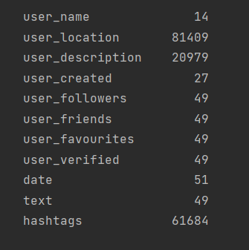
Dataset Attributes
User Name
User Location
User Description
User Created
User Followers
User Friends
User Favorites
User Verified
Date Text Hashtags
Source
Is Retweet
Attributes with NAN values
Notes:
Ivy: Thanks sturart. Unfortunately, Ivy has caught covid and is having a sore throat at the moment, so is unable to present. I will be reading her script for these slides instead. in previous slide, sturart gives a brief introduction on attributes that we will mainly deal with. For the first 4 attributes, they are highly related to the question we are going to predict in next slides. And for the last two attributes, they can give us a general insight on the influence of comments in tweet. After feature engineering, new attributes maybe created.

Slide 8
Dataset Attributes
Attributes to be utilized
User Location
User Followers
Date
Text
Notes:
Ivy: Thanks stuart. Unfortunately, Ivy has caught covid and is having a sore throat at the moment, so is unable to present. I will be reading her script for these slides instead. in previous slide, stuart gives a brief introduction on attributes that we will mainly deal with. For the first 4 attributes, they are highly related to the question we are going to predict in next slides. And for the last two attributes, they can give us a general insight on the influence of comments in tweet. After feature engineering, new attributes maybe created.

Slide 9
Baseline Approach & Novelty
Baseline
Used NLP tool VADER to assess twitter sentiment
LSTM and Bi-LSTM assessed performance at:
90.59% and 90.83% respectively
Novelty
The training process & Feature Engineering
Questions to be answered
Notes:
The sentiments of people regarding vaccines of all sorts were assessed using the natural language processing (NLP) tool, Valence Aware Dictionary for sEntiment Reasoner (VADER).
A recurrent neural network- (RNN-) oriented architecture, including long short-term memory (LSTM) and bidirectional LSTM (Bi-LSTM), was used to assess the performance of the predictive models, with LSTM achieving an accuracy of 90.59% and Bi-LSTM achieving 90.83%.

Slide 10

Methodology
Data analytics is reliant on the process of collecting relevant data, deploying appropriate models and ensuring models work within the domain of choice
The process used for our analysis is
Data preprocessing
Feature engineering
sentiment analysis
Building models
Deploying models
Visualization
Notes:
Briefly go over the process of the modelling process

Slide 11
Data Preprocessing
General machine learning step
Import dataset
Select features (user followers, user location, text, date)
Remove NAN value from “text ” attribute
Convert date to date format
Basic natural language data preprocessing:
Word tokenization
Punctuation, stop-words and common name/location removal
Stemming
Notes:
Due to our questions, we only chose xxxx
There are 21% of na value in location feature, constituting a considerable portion of the data. These were not removed to preserve the integrity of the originally collected data.
Might not have used stemming in the coding

Slide 12
Feature Engineering - NLTK
Explored various modeling options to understand the data
Using NLTK library for sentiment analysis
NLTK encompasses powerful built-in machine learning operations and contains various utilities

Slide 13
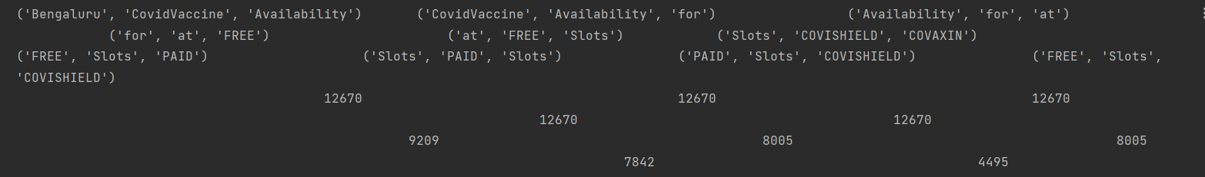
Feature Engineering - Data exploration
Using movie dataset from NLTK to find positive and negative words frequency
Remove words that are both classify as positive and negative
Extract top 200 frequency positive / negative words from NLTK movie dataset
The top 10 trigram are referring to covid availability

Slide 14
Feature Engineering Method of Extracting Features
Method 1
Calculate dimensions using the words labelled as positive and negative
Mean compound score
Probability of current comment being positive/negative
Total number of positive/negative words in current text
Use five above dimensions to value
Give score for each sentence / words
Method 2
Use 400 words selected before to evaluate
Notes:
Our group explored various modeling options for understanding our data and ended up utilizing python’s NLTK library for sentiment analysis. NTLK was deployed as it encompasses powerful built-in machine learning operations and contains various utilities, which allowed us to effectively manipulate and analyze linguistic data.\
NLTK is a leading platform for building Python programs to work with human language data. It provides easy-to-use interfaces to over 50 corpora and lexical resources such as WordNet, along with a suite of text processing libraries for classification, tokenization, stemming, tagging, parsing, and semantic reasoning, wrappers for industrial-strength NLP libraries, and an active discussion forum.

Slide 15
Model Selection
Make training dataset from movie comments, and label them as positive/negative
Our approach utilized the following models in evaluating to determine which would work best for our model
Bernoulli NB
Complement NB
K-Neighbor Classifier
Decision Tree Classifier
Random Forest Classifier
Logistic Regression
MLP Classifier
AdaBoost Classifier

Slide 16
Model Evaluation
Model | Accuracy of A (top 4) | Model | Accuracy of B (top 4)
Logistice Regression | 75.50% | Multinomial NB | 79.50%
MLPCLassifier | 75.50% | Complement NB | 79.50%
AdaBoostClassifer | 75.25% | Bernoulli NB | 78.50%
RandomForest Classifer | 74.25% | MLPCLassifier | 75.25%
Notes:
As illustrated on the attached picture, our approach utilized 9 models in evaluating the the highest accuracy one for our analysis. The models were:
- Bernoulli NB
- Complement NB
- K-Neighbor Classifier
- Decision Tree Classifier
- Random Forest Classifier
- Logistic Regression
- MLP Classifier
- AdaBoost Classifier
Building training and testing dataset, extract features from postive comment and label as positive, extract features from negative comments and label as negative. We decide to use mppclassifer model, and using movie comment to train the classifer to train. (it's hard to say which one is best because we are using the movie comment instead of mannully labels. In this case, we are going to use mplclassifier to)
Could just use this slide to explain the model performance:
What are the evaluation metrics used to measure the performance, and how does this compare to the baseline (doesn’t have to be state-of-the-art algorithm)
How the model compares to the baseline, why does it not perform better/perform better than the baseline
How sensitive are the results to the parameters? What about the effects of changing the training/testing set size?
Explain the error rates, the performance. Why are the performance high/low?

Slide 17
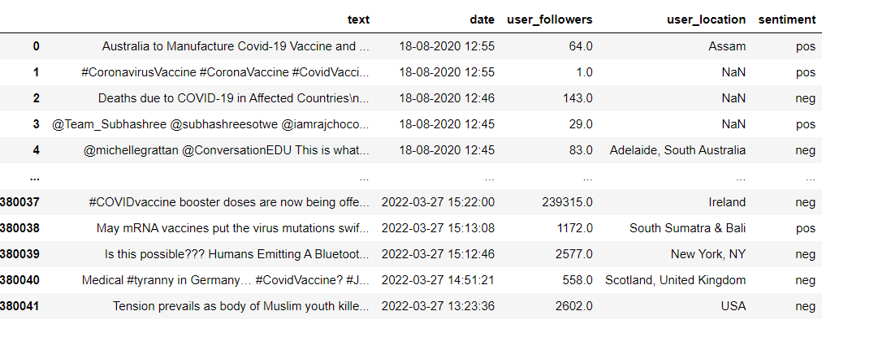
Results
Notes:
Same as a csv documents, so we can do following statistical analysis without runing previous coding. Also, because of two methods of extracting features, we get two results, and rougly go through by ourselves and there's not much difference. So we choose first result to do following analysis.

Slide 18

Model Performance
MLP Classifier 's performance is defined by accuracy (75.5%)
It does not perform better than the LSTM (90%)
Changing iteration and training size will affect the accuracy (0.8%)
Notes:
As we mentioned before MLP classifer's can achieve 75.5% accuracy, and can be stationary applied on both feature extraction method.
Comparing to baselne, the model does not perform better. It may because of multiple reasons.
Difference in the training process, LSTM and bi-LSTMs have more comprehensive training done 2 possibly hyperparameter tuning.
By ...

Slide 19
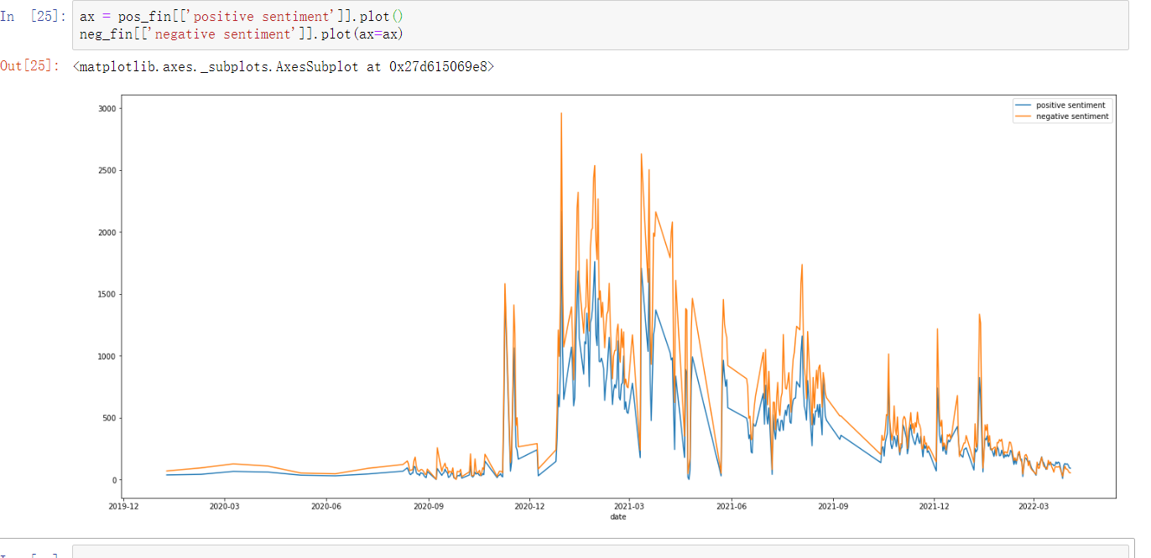
Visualization – Date Method 1
Notes:
As we see from graph, negative sentiment is always higher than positive sentiment at any timepoint, the first spik is around December 2020, which is the time vaccine created, then, the discussion of covid vaccine got its peak soon after and gradugally decreasing. Every three month, there exists little spiks may because of the outbreake of new variant covid or the poly changes.

Slide 20
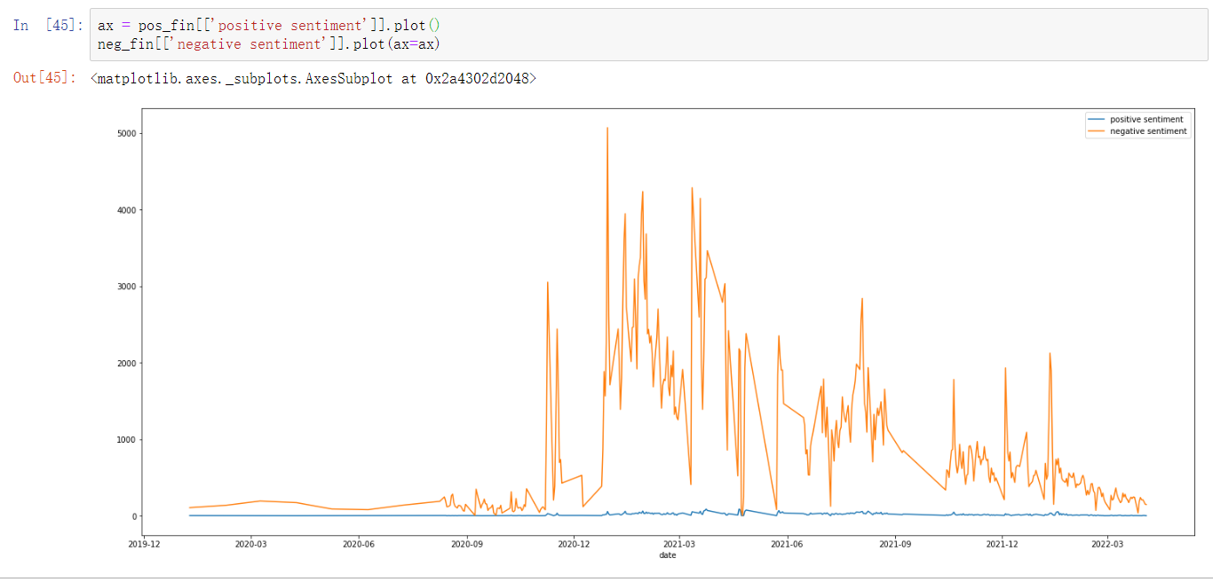
Visualization Date Method 2
Notes:
This plot is createded by the prediction result using second method of feature extraction. The negative sentiment fis almost same as the preivies one, but the number of positive sentment is super low. It’s reasonable but also makes us confused on why . There’s no obvious codding error in processing, s we may need to do some research or use another model to predic to see if we can find reason

Slide 21
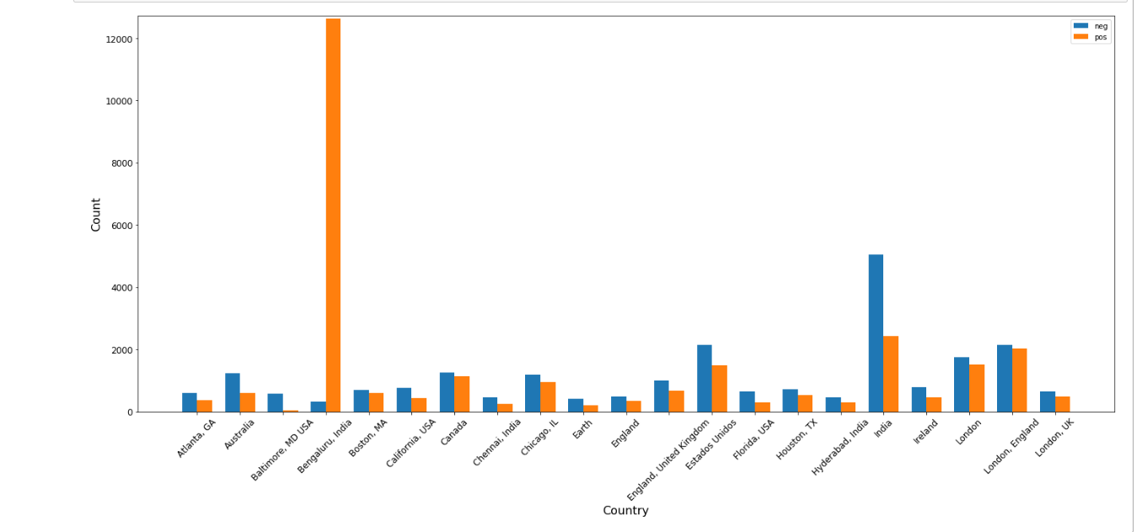
Visualization – City and Country
Notes:
In this and the next slide we will be visualizating sentiments grouped by location. Here you can see that almost all of the locations have more counts of negative sentiments than positive sentiments with one exception being Bengaluru of India. The abnormal proportion of positive counts here will be discussed later in the discussion.

Slide 22
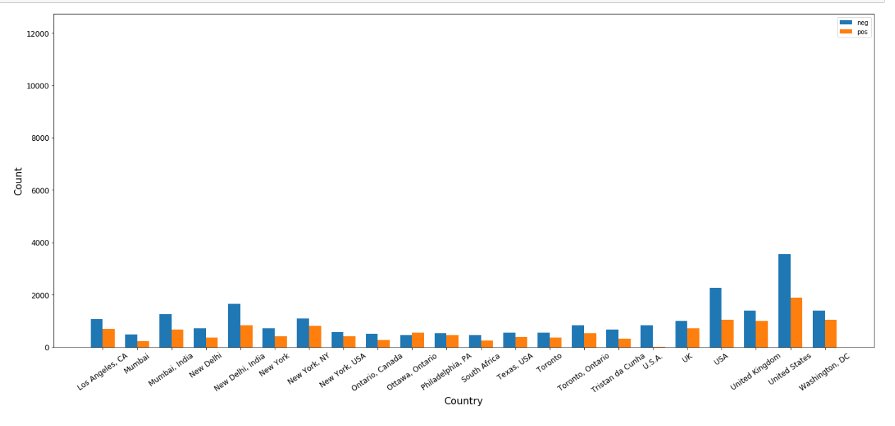
Visualization – City and Country
Notes:
On this graph, you can see that all of the locations listed have more negative sentiments than positive sentiments, with the highest counts being in the US, Uk and New Delhi of India.

Slide 23
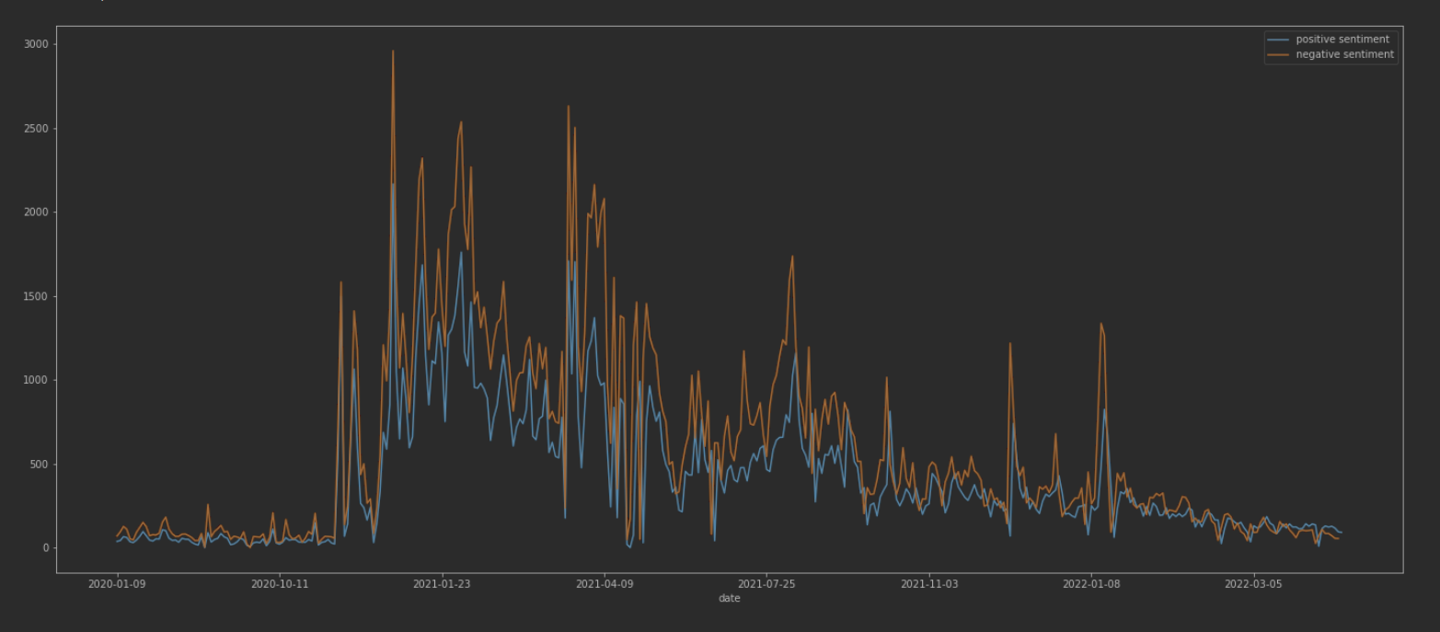
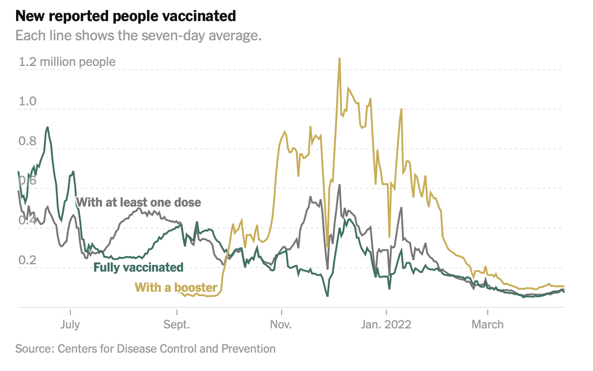
Question 1 -USA Sentiment Change/Vaccination rate
Notes:
Are sentiments towards covid vaccines related to vaccination rates?
The first question to our project was whether sentiments towards covid vaccines were related to vaccination rates. The graph on the top shows the counts of positive and negative sentiments in the US from July 2021 to march 2022. The graph on the bottom shows the number of people newly vaccinated with three different lines corresponding to people who have just gotten their first dose, people who got their second dose and ppl who got their booster shot.
By comparing the two graphs, you can see that whenever there is a spike in positive sentiments in the top graph, there is a spike in the lines on the bottom graph indicating an increase in number of people getting vaccinated.

Slide 24
Question 2 & 3
2. How has sentiment towards covid vaccine & the pandemic changed since 2020?
More negative sentiments than positive sentiments at any timepoint. Vaccination rollout led to spikes sentiment counts. Counts decreased with opening of epidemic policy.
3. Which country has a generally positive sentiment towards covid vaccines and which ones has negative sentiments?
India, US and Australia had twice the amount of negative sentiments than positive ones. No country has a generally positive sentiment.
Notes:
Are sentiments towards covid vaccines related to vaccination rates?
Which country has a generally positive sentiment towards covid vaccines and which ones has negative sentiments?
More negative sentiments than positive sentiments at any timepoint. When vaccination rollout began, there were spikes in the number of tweets expressing sentiments towards vaccines and the pandemic. The discussion towards vaccine decreased with the opening of epidemic policy.

Slide 25
Discussion & Conclusion
Initially thought about manually labelling sentiments. Didn’t proceed with it due to the time constraint.
For visualization of the trends in sentiment irrespective of time, using method 2, the line representing positive sentiment counts deviates greatly from line obtained using method 1.
For Q1, we did not have tabular data on the vaccination rate for covid-19, therefore we had to retrieve graph directly from the CDC to answer the question.
For Q2, India had extremely high pos sentiment counts compared to neg ones.
MLP model was used to compare two extraction methods. Most accurate model was Multinomial NB, and will try later.
Notes:
Before starting our coding, we are thinking about manuualy labeeling sentiments because our dataset do no have label. Labling by ourself can make sure the training dataset is good. We are planning to label at least 2000 of them to train model. However, due to the limited time, we use movie comments from NLTK to train model. It works because English words towards different sentiment are same.
As I mentioned before, we are not sure the reason why the line representing positive sentiments counts deviated greatly due to different extraction methods. It may because model consider too much dementions, and over value the positive words. We will keep trying to figure out.
When answer question 1, we do not know if the people made tweets being vaccinated or not, so we can not just created a plot and find the relationship. The alternative method
Is choosing US as example, and combe with graph showing US vaccination rate to answer question
For question 2, we still don’t know why there exists such high amount of positive sentiments in Balitimore India. However, at the right side of the graph, there’s another india with more regular amounts on both positive and negative amounts. we suspect it’s because the tweeter address do not need to confirm, and number comments from indea is largest a
For model part, in this task, we use MLP model because it shows best performance on method 1, and we want to use same model to compare with method 2. however, MNB has better accuracy when using second method, so we will try later and see if there’s any difference on result.
In conclusion, sentiments towers pandemic and vaccine do changes through the time. Number of positive and negative senments shows different by country. In these days, people is start coexisting with the virus, and the discussion about covid died down.

Slide 26
Thank you!

Slide 27
References
Alam, K. N., Khan, M. S., Dhruba, A. R., Khan, M. M., Al-Amri, J. F., Masud, M., & Rawashdeh, M. (2021). Deep Learning-Based Sentiment Analysis of COVID-19 Vaccination Responses from Twitter Data. Computational and Mathematical Methods in Medicine, 2021.
Centers for Disease Control and Prevention. COVID Data Tracker. Atlanta, GA: US Department of Health and Human Services, CDC; 2022, April 19. https://covid.cdc.gov/covid-data-tracker

